Slide 1


Al – Tamayuz Electronics Store Project
Prepared by: Karim Kamel
1

Slide 2

Agenda:
1
2
3
4
5
Project Introduction
Database overview
SQL Analysis & Metrics
Dashboard & Visualizations
Insights & Recommendations
Overview of the project’s goal: analyzing sales performance to support strategic decisions and business insights.
Brief explanation of the ERD Diagram, tables (Customers, Products, Sales), key attributes, and dataset summary.
Key queries and calculations: Total Revenue, Total_Value, Category Performance, Customer Ranking, and High-Value Products.
Overview of Excel dashboard: KPIs (Total Revenue, Units Sold), Pie Chart for country distribution, Bar Chart for category revenue, and interactive slicers.
Summary of key findings: top-performing countries, categories, and customers, plus optimization suggestions for scaling the database and improving reporting.
2

Slide 3
Project Overview:
The project is based on a database containing 300 customers, 100 products, and 5,000 sales transactions across multiple product categories such as Tech, Sports, Home & Kitchen, Furniture, and Accessories.
A comprehensive analysis was performed to examine sales trends, total revenue, product performance, and customer behavior.
The results are presented in an interactive Excel dashboard, featuring:
Key metrics (KPIs): Total Revenue, Total Units Sold
Visualizations: Pie Chart showing sales distribution by country and Bar Chart showing revenue by product category
Interactive elements: Slicers for filtering by country and time
This dashboard provides a clear, visual summary of sales performance, enabling quick insights into top-performing products, customers, and regions.
3

Slide 4
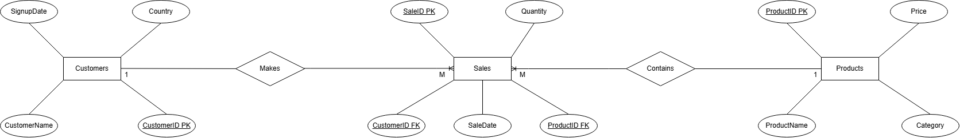
Entity Relationship Diagram:
4

Slide 5
Normalization:
Customers
Customer_ID | Customer_Name | Country | Signup_Date
Sales
Sale_ID | Customer_ID | Product_ID | Quantity | Sale_Date
Products
Product_ID | Product_Name | Category | Price
This database is normalized up to Third Normal Form (3NF). Each table has a clear primary key, and the Sales table works as a bridge table between Customers and Products. All non-key attributes depend only on their table’s primary key, and there are no repeating groups or many-to-many relationships stored directly inside one table.
5

Slide 6
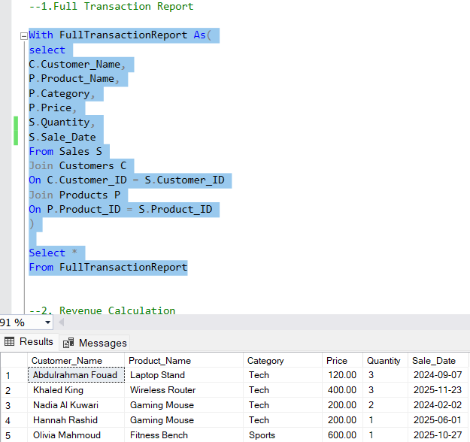
SQL Queries:
6

Slide 7
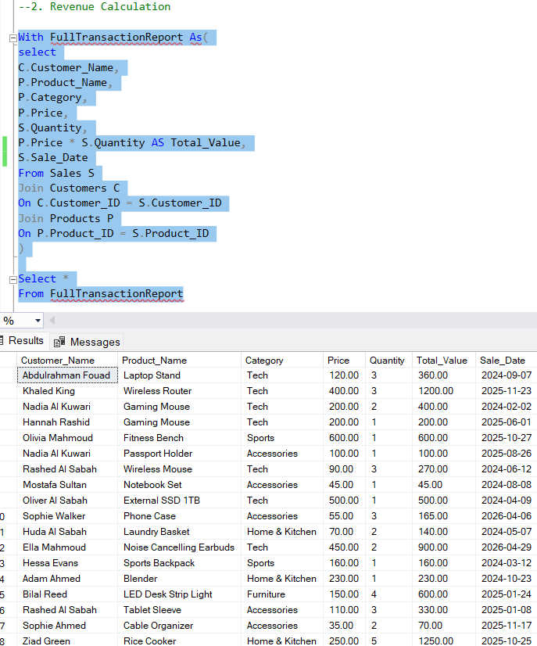
SQL Queries:
7

Slide 8
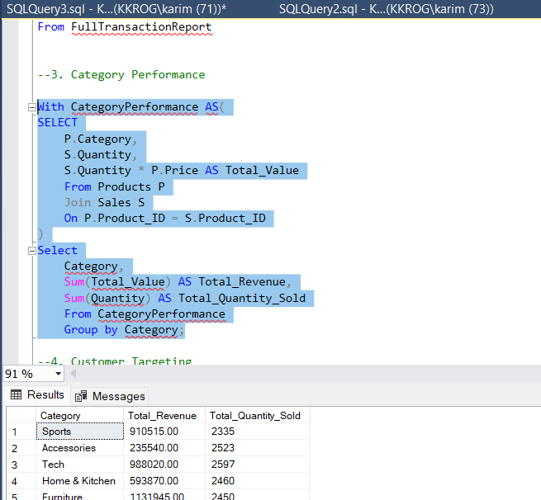
SQL Queries:
8

Slide 9
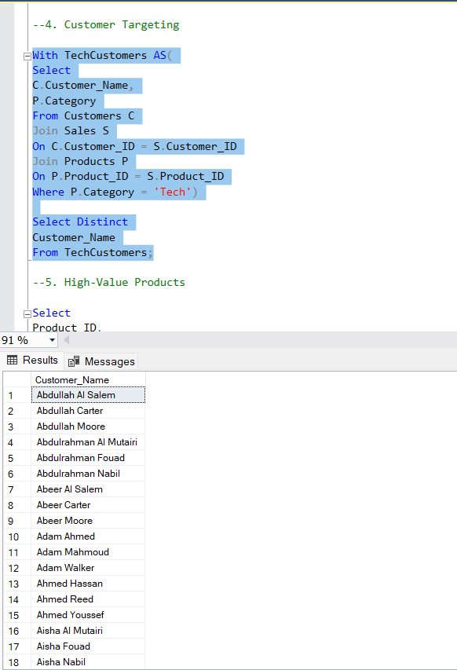
SQL Queries:
9

Slide 10
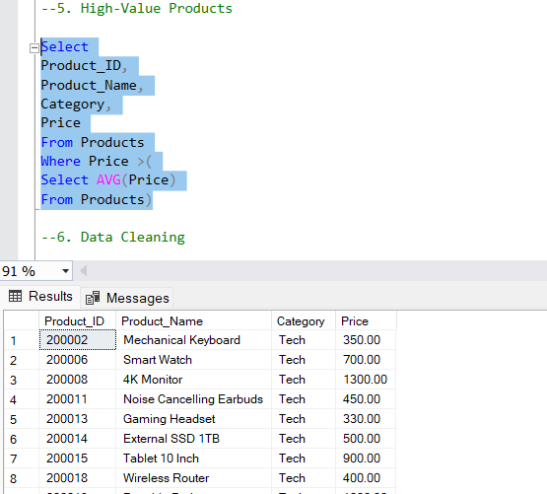
SQL Queries:
10

Slide 11
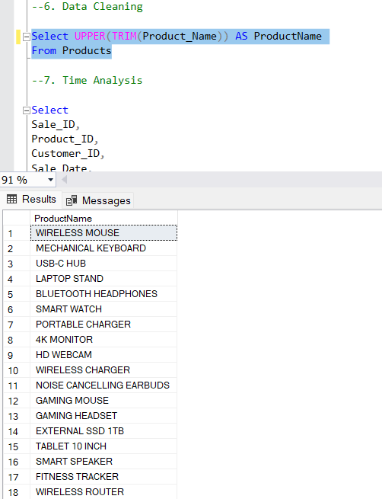
SQL Queries:
11
3

Slide 12
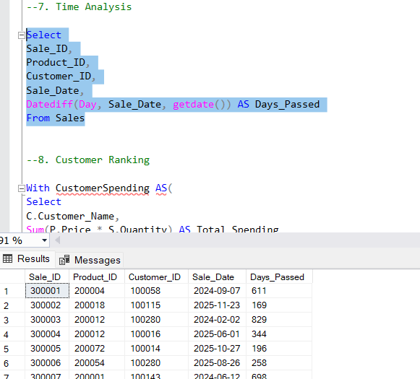
SQL Queries:
12
3

Slide 13
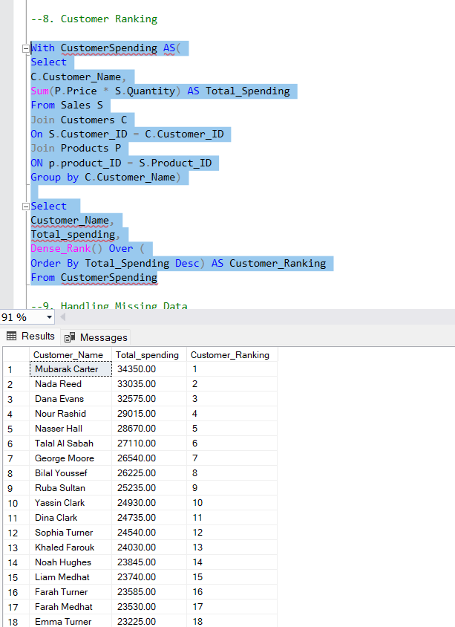
SQL Queries:
13
3

Slide 14
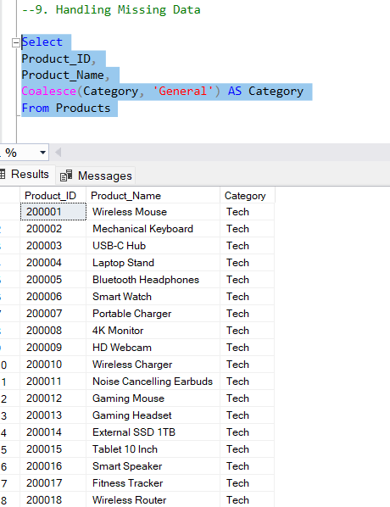
SQL Queries:
14
3

Slide 15
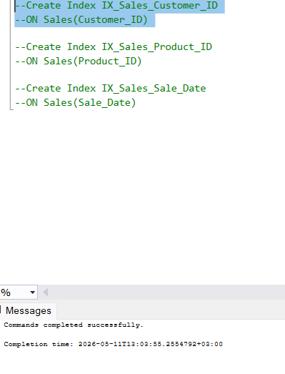
SQL Queries:
Optimization Plan
--If the Sales table grows to 10 million rows, the database may become slower, especially when joining
--tables or filtering sales records. To improve performance, I would add indexes on important columns
--such as Customer_ID, Product_ID, and Sale_Date.
15
3

Slide 16
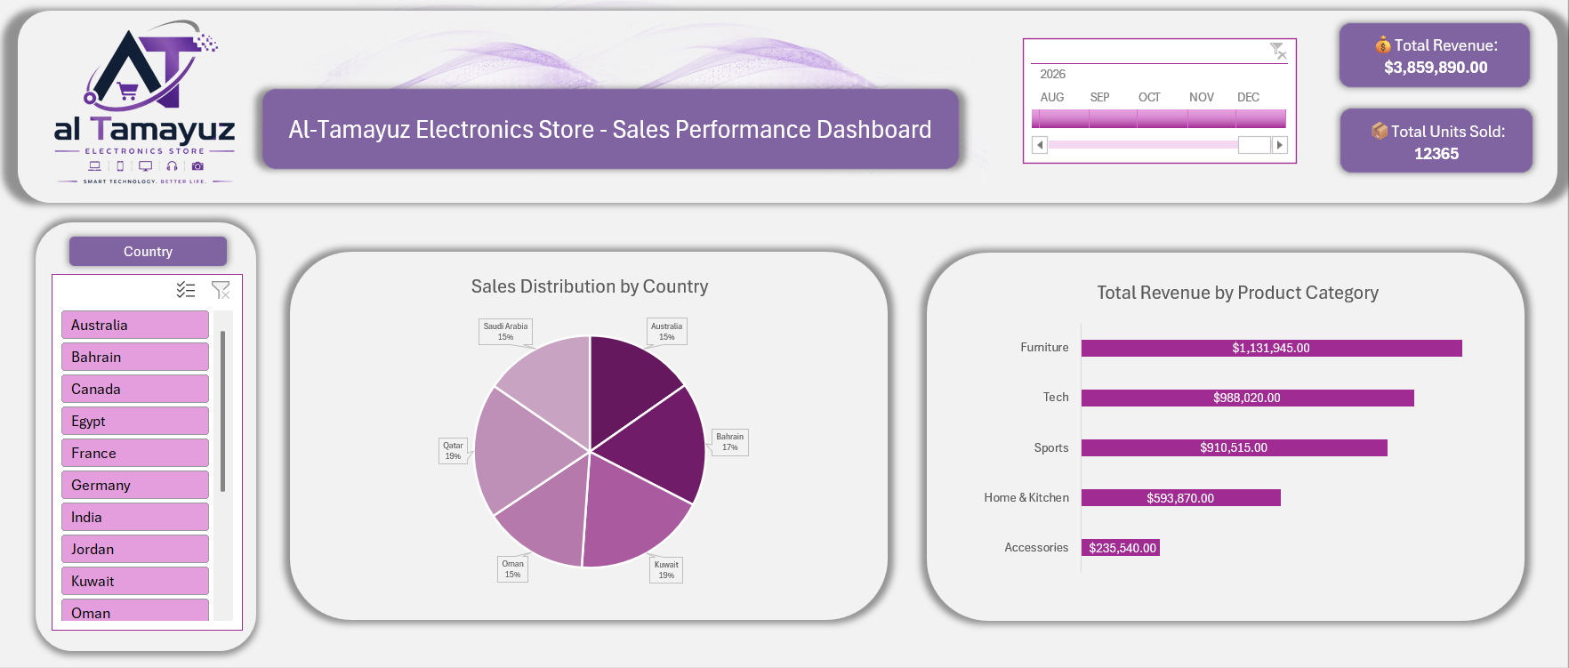
Dashboard’s Overview:
16
3

Slide 17
Dashboard’s Overview:
17
3

Slide 18
Dashboard’s Overview:
18
3

Slide 19
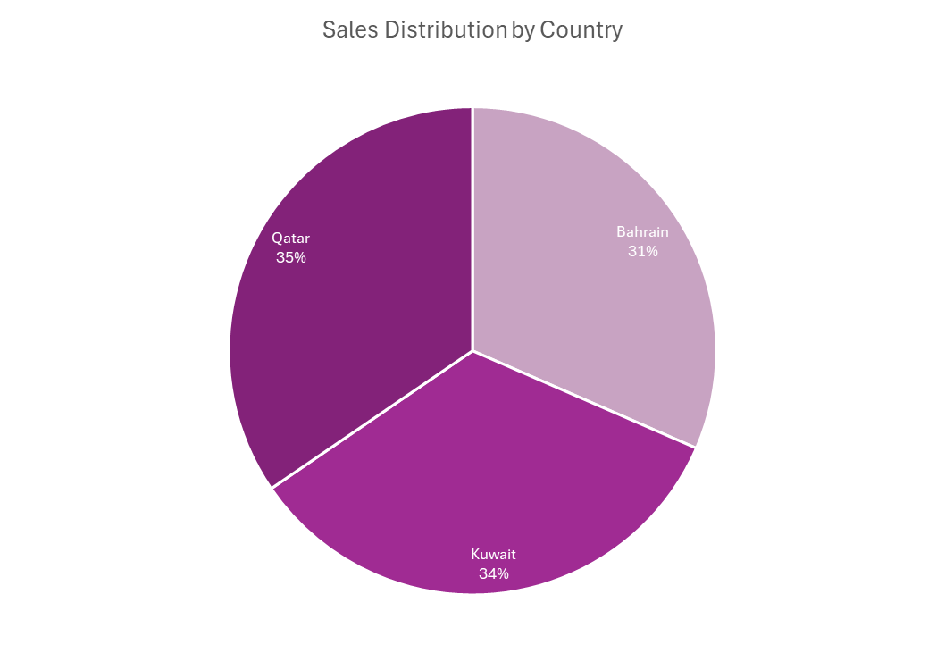
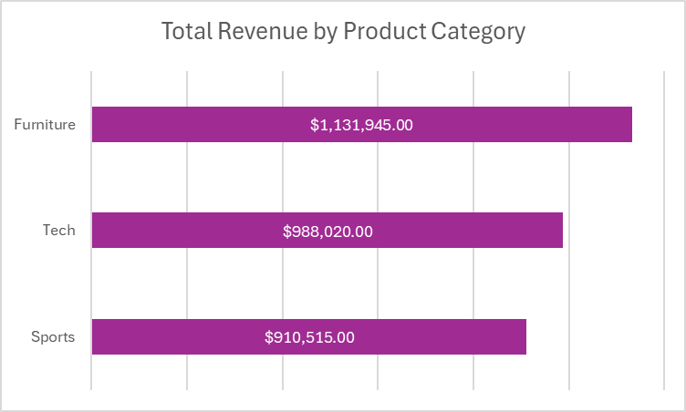
Insights & Recommendations:
For 3 years period our Top 3 Revenue-Generating Categories & Countries:
Furniture – highest contributor to total sales revenue
Tech – strong performer with consistent demand
Sports – third highest in revenue contribution
19
3

Slide 20
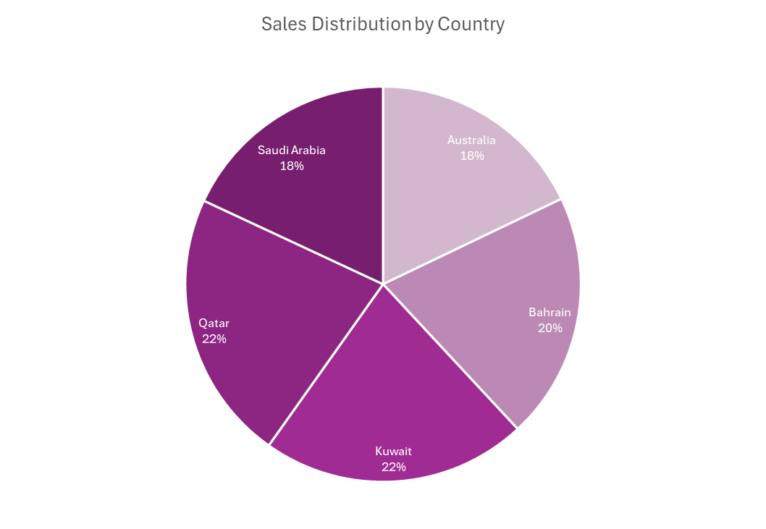
Insights & Recommendations:
Top 5 Countries:
20
3

Slide 21
Insights & Recommendations:
Lowest 5 Countries:
21
3

Slide 22
Insights & Recommendations:
Top 5 selling products:
22
3

Slide 23
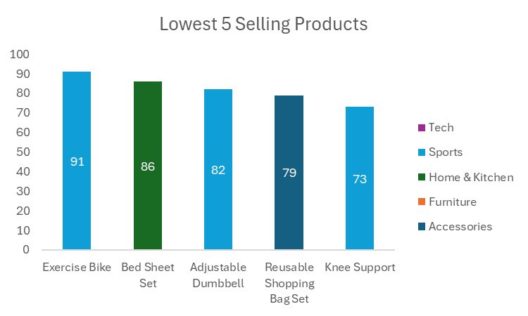
Insights & Recommendations:
Lowest 5 selling products:
23
3

Slide 24
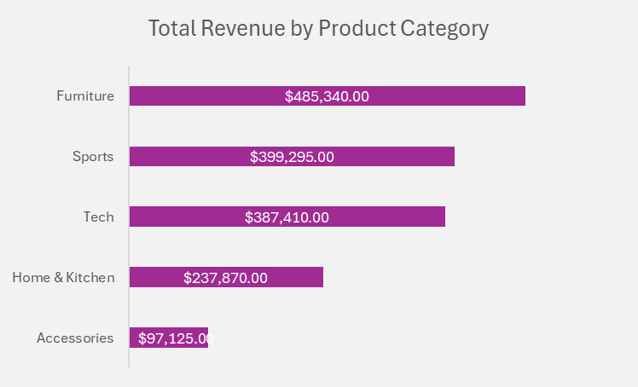
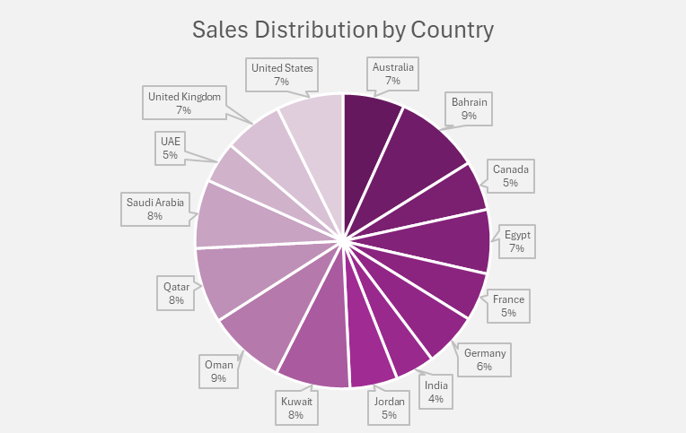
Insights & Recommendations:
(YOY) In 2024, our top selling Categories & Countries:
📦Total Units Sold: 5178
💰Total Revenue:
$1,607,040.00
Business launched in 2024.
24
3

Slide 25
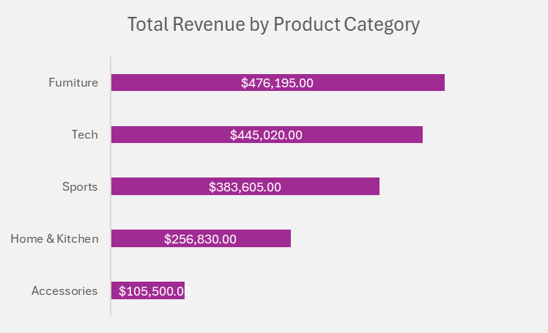
Insights & Recommendations:
(YOY) In 2025, our top selling Categories & Countries:
📦Total Units Sold: 5402
💰Total Revenue:
$1,667,150.00
3.4% Growth in comparison with the past year.
25
3

Slide 26
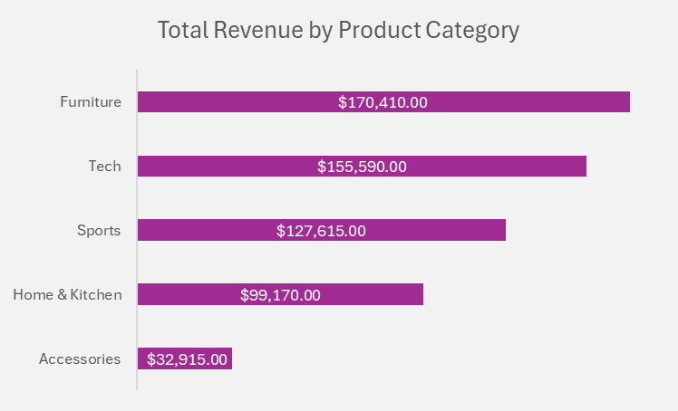
Insights & Recommendations:
(YOY) In 2026, our top selling Categories & Countries:
📦Total Units Sold: 1785
💰Total Revenue:
$585,700.00
6% Degrowth in comparison with the same period from the last year
26
3

Slide 27
Insights & Recommendations:
Recommendations:
Boost Sales in High-Performing Categories
The Furniture, Sports & Tech categories are doing really well. It’s important to maintain this momentum by running targeted promotions and strategic marketing in these areas.
At the same time, we should focus on improving sales in Home & Kitchen and Accessories, which are currently underperforming, through targeted campaigns and promotions.
Build Stronger Relationships with Top Customers
A small group of high-value customers contributes significantly to total revenue. We should look into customer retention programs, like a loyalty scheme or personalized offers, to encourage these customers to keep coming back.
27
3

Slide 28
Insights & Recommendations:
Recommendations:
Reallocate Premium Stock for Optimal Availability
To ensure that we never run out of stock in high-performing regions, consider redistributing premium stock from underperforming countries. This will help us meet demand in regions with stronger sales while still maintaining an appropriate inventory level in lower-performing countries, avoiding stockouts and overstocks.
Focus on Expanding Sales in Underperforming Regions
Some countries are lagging behind in sales. By running targeted campaigns in these regions and tailoring them to local preferences, we can increase awareness and drive sales. A localized approach based on specific market needs could significantly improve performance.
28
3

Slide 29
Thank you
29
3

